Slide 1

Search Engine
Presented to:-
Dr.Luis Rueda
School of Computer Science
University of Windsor
Presented By:-
Ami Patel-104870549
Bhushan Joshi-104840108
Devanshi Khanna-104843415

Slide 2
Index
Introduction
Features
Flow Diagram
Demo

Slide 3
Introduction
It is a search engine project that searches the occurrence of the keyword in a particular text file which is converted from HTML file and then displays the results in a sequence.
We have used :
Eclipse
Tomcat Version 8
Technologies : Java , JSP , Servlet.

Slide 4
Topics Covered in our Project
Word frequency count using (Boyer Moore Word Matching).
Sorting Operation(Quick Sort For Frequency counted words).
Web page ranking using sorting algorithms(Quick Sort ).
Spelling Checking and Suggestion using (Edit Distance).
HTML to Text Conversion(Jsoup).

Slide 5
Boyer-Moore
Most efficient string-matching algorithm.
The algorithm scans the characters of the pattern from right to left beginning with the rightmost one. In case of a mismatch (or a complete match of the whole pattern) it uses two precomputed functions to shift the window to the right.
These two shift functions are called the good-suffix shift (also called matching shift and the bad-character shift (also called the occurrence shift).

Slide 6
The user searches for a keyword in the text converted HTML files where each word is stored in a array List of strings.
When user presses the search button on the webpage. The keyword/user input pattern is matched with the words in list and it will also show the file name and the occurrence of that word in that html file.
It will show this list of files and the occurrences of words in descending order.
So the first page would be the one which has highest occurrences of word.

Slide 7
Quick Sort
Web page ranking is final part of search result for delivering relevant results. Implemented using Quick sort algorithms.
High performance.
Fast in almost all cases.
Stable than any sorting algorithms.
Quick Sort allows to calculate the number of inversions.
It performs sorting within the array thus it does not need extra space to store the sorted elements.

Slide 8
Edit Distance
The edit distance measures the minimum number of operations required to transform one string into the another string.
Automatic spelling correction, plagiarism detection and speech recognition is determined using Edit Distance Algorithm.
This operation helps us to find the correct word from the dictionary and suggestion.

Slide 9
We have used edit distance for the suggestion of the words.
It will work as when user inputs a word with editdistance as suffix, it would be compared to the words in the dictionary and the nearest correct words would be suggested using this algorithm.
It will print first 5 words that have minimum distance.

Slide 10
Flow
INPUT
BOYER-MOORE
OUTPUT
EDIT-DISTANCE
OUTPUT
(Word) frequency
(Word) Edit
Quick Sort

Slide 11
Screen Shots

Slide 12
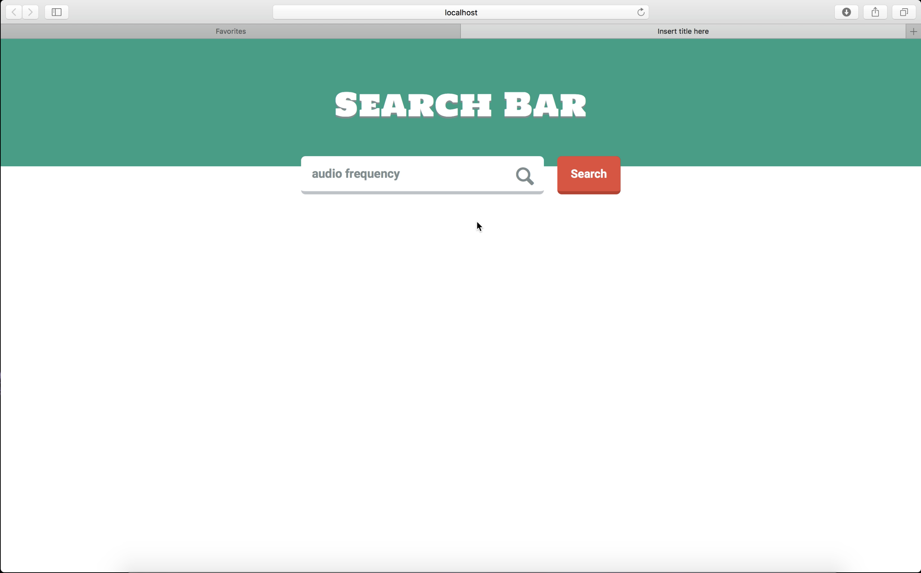
Search for a word in 100 html files

Slide 13
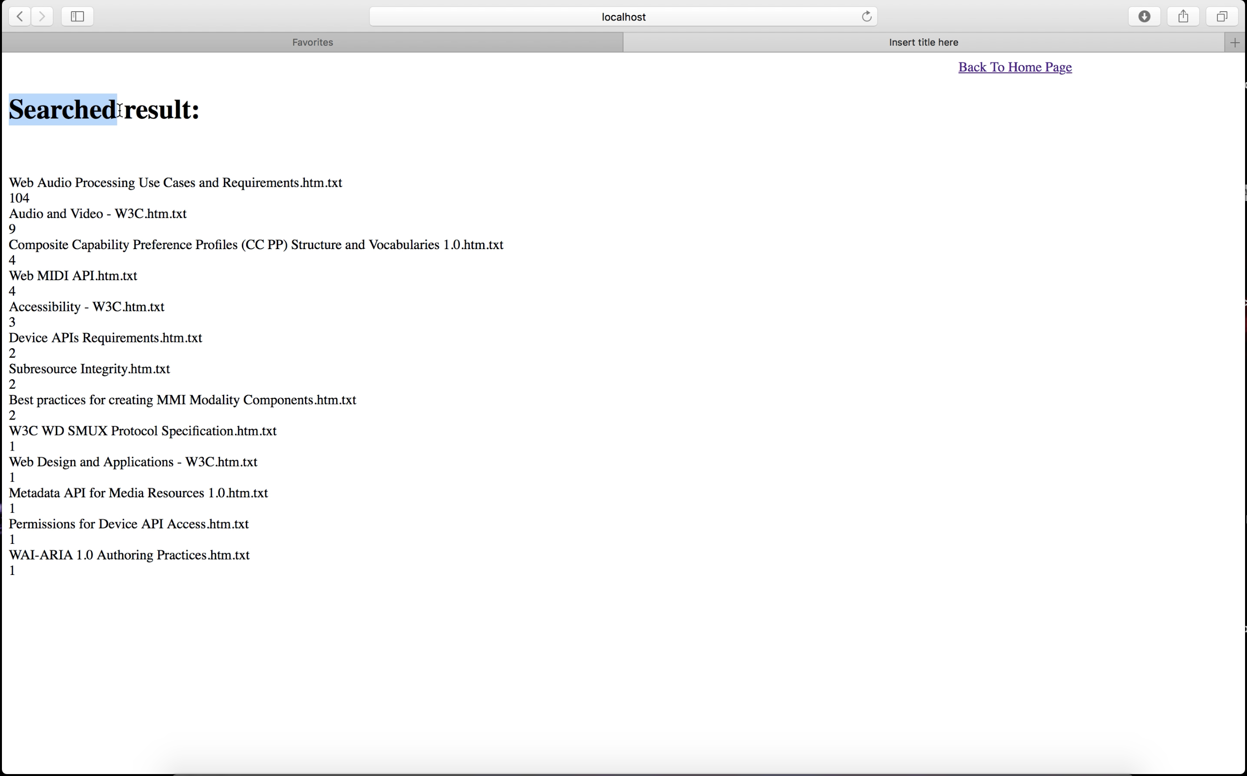
Results for a particular keyword with its occurrence

Slide 14
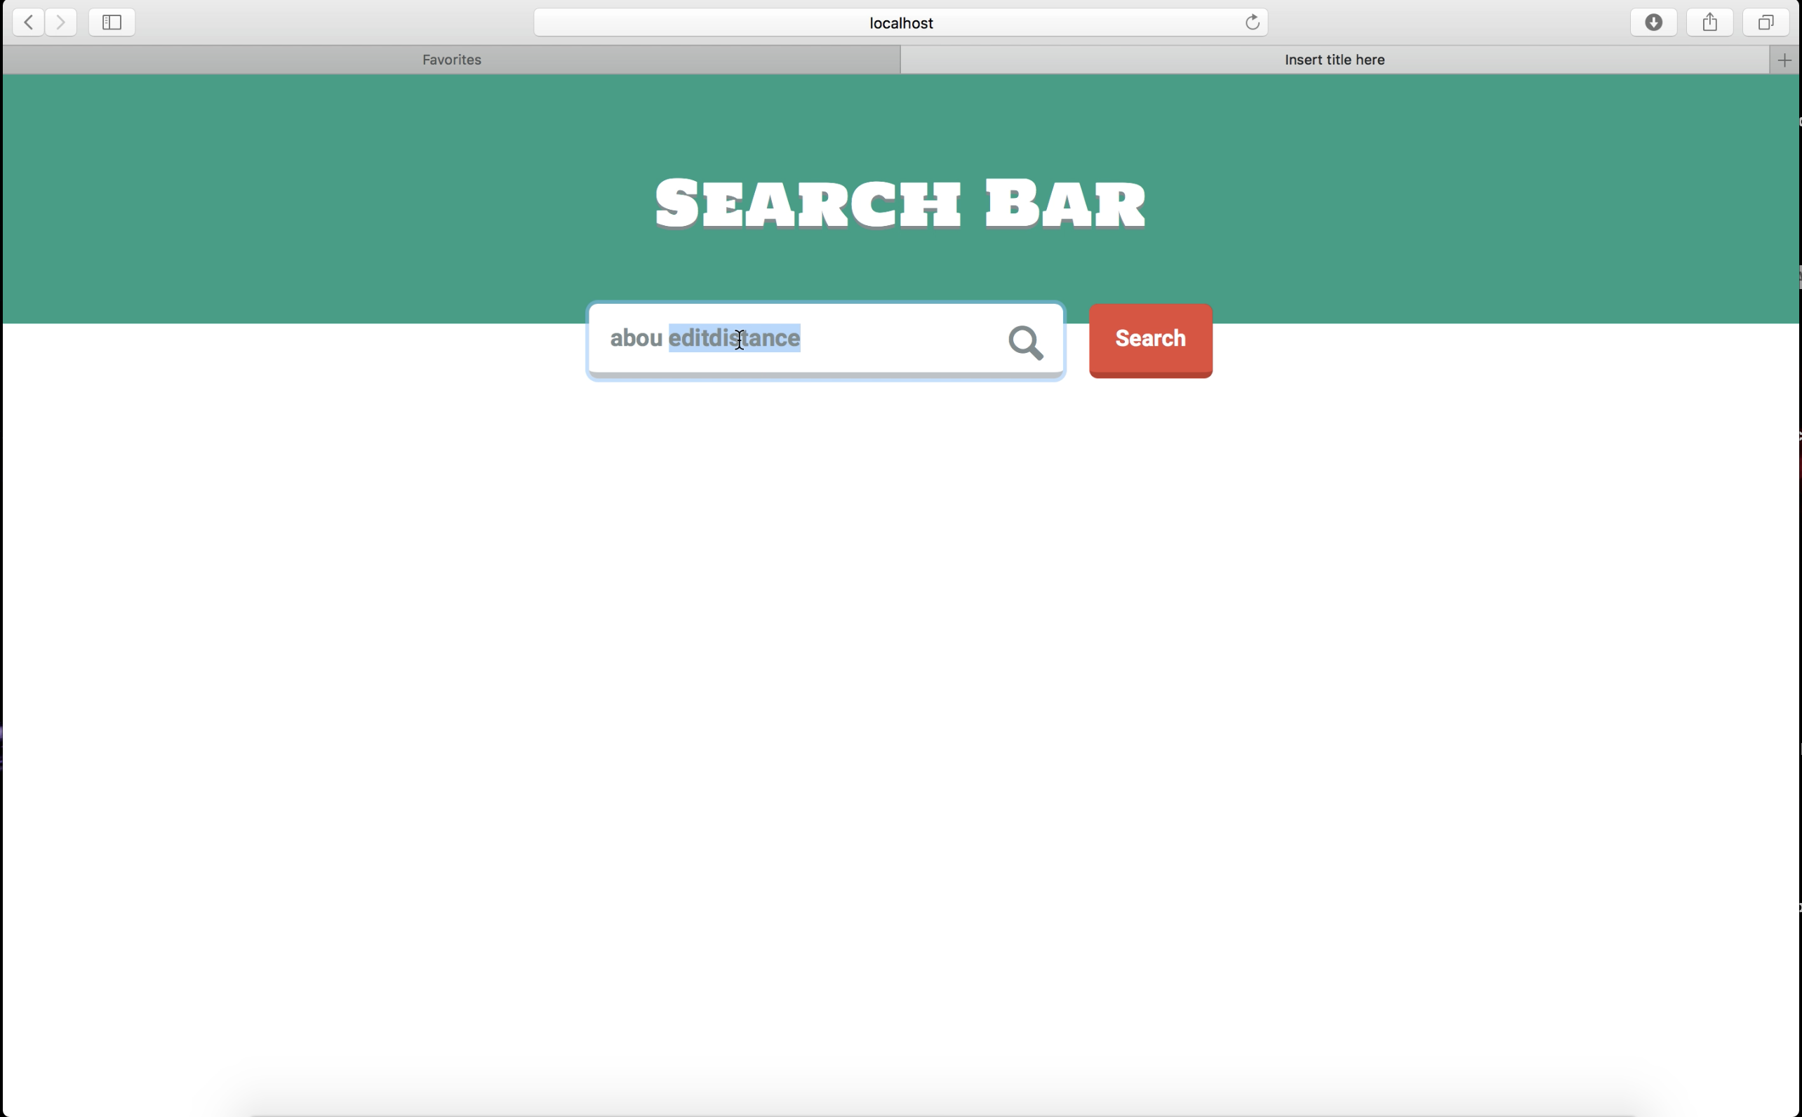
Searching the nearest word using edit distance

Slide 15
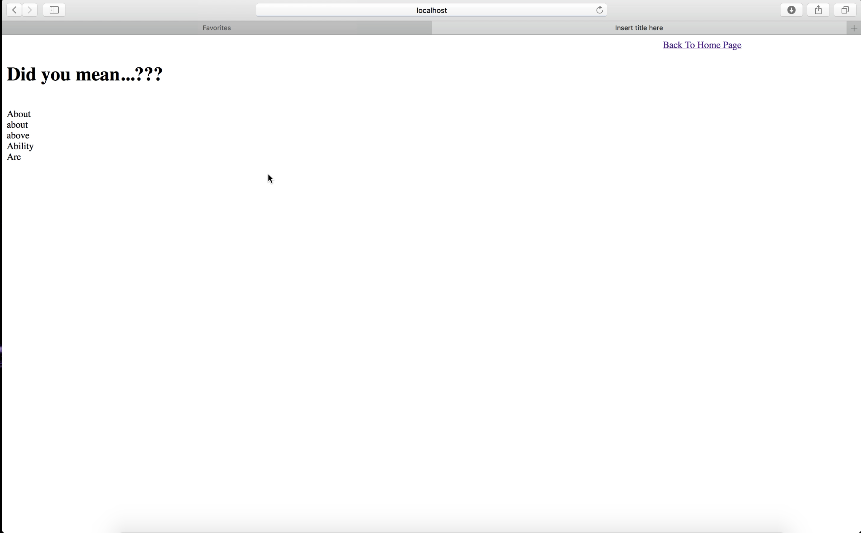
Output of the nearest word using edit distance

Slide 16
References
HTML files provided by Dr Rueda.
https://www.daniweb.com/programming/software-development/threads/127733/help-to-design-a-simple-search-engine-in-java
https://stackoverflow.com
https://en.wikipedia.org/wiki/Boyer–Moore_string_search_algorithm
https://en.wikipedia.org/wiki/Edit_distance
https://en.wikipedia.org/wiki/Quicksort
Class slides by Dr Rueda

Slide 17
Thank You

